Slide 1

Global Healthcare Data
ETL & Analysis CLI
Building a Robust Command-Line Application
RAVI VAMSHI D N MS FABRICS

Slide 2
Tables of contents
Project Overview
Learning Objectives
Core Requirements: ETL Pipeline
Core Requirements: CLI & Analysis
Technical Specifications
Testing & Validation – ETL Pipeline
Database Design
Sample Queries & Analysis
Conclusion

Slide 3
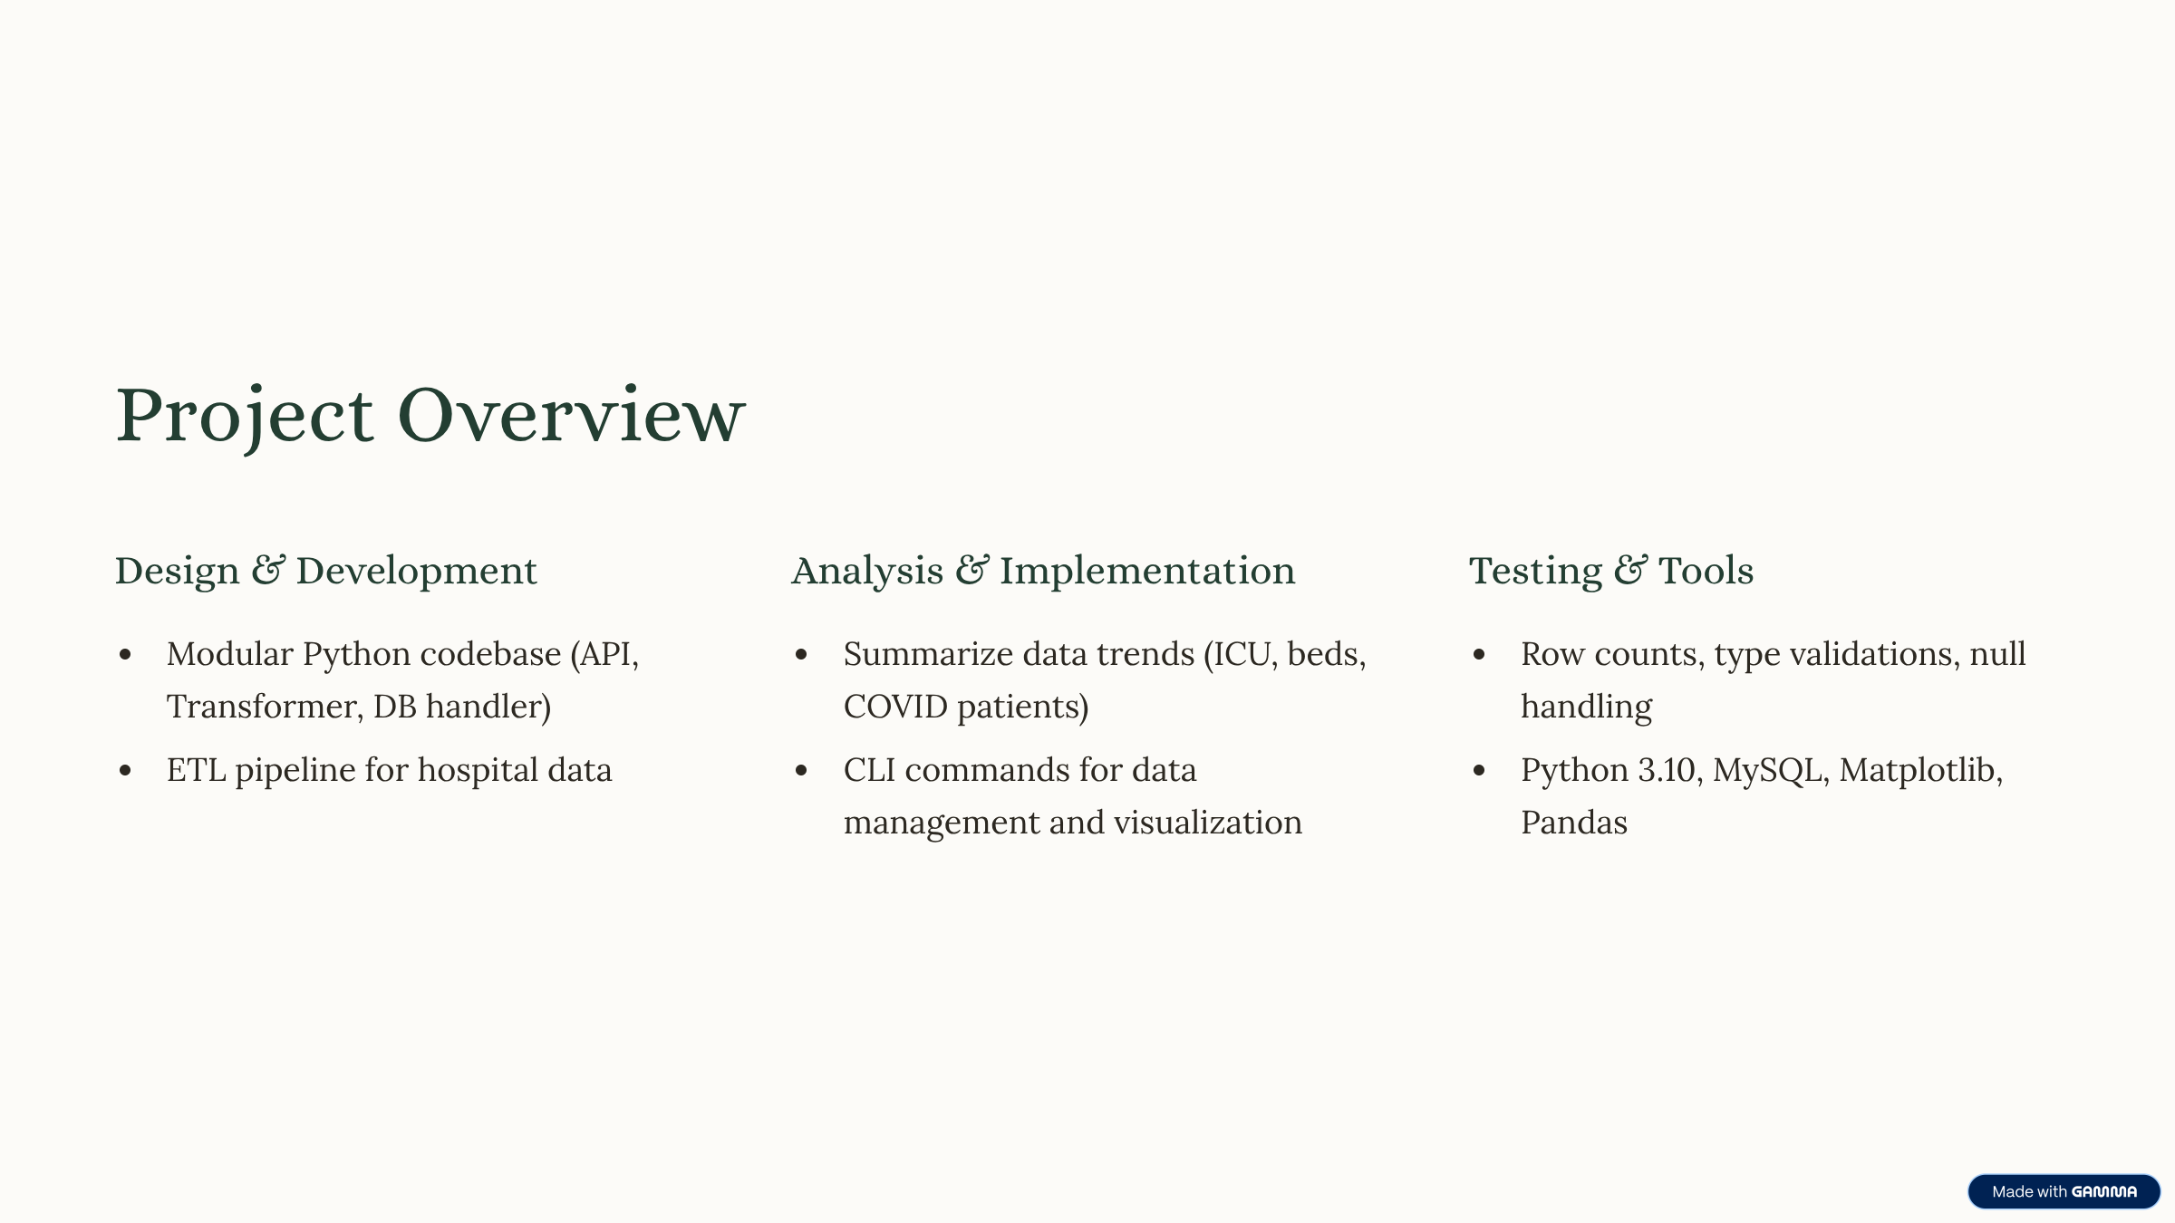


Slide 4





Learning Objectives
API Interaction
Data Transformation
Database Management
Master interacting with RESTful APIs for data extraction.
Implement robust data cleaning and transformation techniques.
Design and manage relational database schemas in MySQL.
CLI Development
Data Analysis
Build a user-friendly and functional command-line interface.
Perform basic data analysis and reporting using SQL queries.

Slide 5

Core Requirements: ETL Pipeline
1. Data Extraction
3. Data Transformation
Connect to a public healthcare API.
Parse JSON/XML into structured Python format.
Handle authentication and rate limits.
Perform data cleaning (missing values, types, duplicates).
Fetch data based on user parameters.
Apply business logic transformations.
Gracefully handle API errors.
Enforce target data schema.
3. Data Loading
Establish MySQL connection.
Create necessary tables (DDL).
Implement efficient batch insertion.
Handle incremental loads.
Implement error handling for DB operations.

Slide 6
Core Requirements: CLI & Analysis
CLI Interface
Query Commands
Enables users to analyze hospital trends like ICU usage and COVID patient loads.
Supports state-wise and time-based data summaries directly via terminal.
fetch_data
list_tables
query_data [parameters]
drop_tables

Slide 7
Technical Specifications
API Integration & Parsing
Data Cleaning
Connects to and fetches data, successfully parsing JSON/XML into structured Python objects.
Implements at least 3 types of data cleaning (e.g., null handling, type conversion, standardization).
MySQL & Loading
Error Handling & Logging
Designs appropriate tables, efficiently loads transformed data, and includes incremental loading logic.
Robustly handles API, database, and processing errors, with Python logging for tracking.

Slide 8





Technical Specifications: CLI & Reporting
CLI Framework
Data Fetch Command
Query Commands
Uses argparse or Click for a structured CLI.
fetch_data command with parameters (e.g., hospitalname, sate icubeds).
At least 3 pre-defined analytical query commands.
Tabular Output
DB Management
Displays query results clearly in the terminal.
list_tables and drop_tables commands.

Slide 9
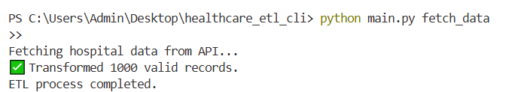
Testing & Validation – ETL Pipeline
3) MySQL Data Loading:
Tested initial and incremental data loads.
Verified primary key constraints and timestamp correctness.
(1) API Client:
Verified data fetching with valid and invalid inputs.
Tested for API downtime, invalid URLs, and rate limiting.
(2) Data Transformation:
Handled missing values, wrong data types, and duplicates.
Ensured data aligned with the defined MySQL schema.

Slide 10
DATABASE DESIGN
Hosipital_covid_stats table
vaccination_data table
Column Name
Data Type
Constraints
Column Name
Data Type
Constraints
id
INT
PRIMARY KEY, AUTO_INCREMENT
Inpatient_beds
FLOAT
DEFAULT 0.0
collection_week
DATE
NOT NULL
Icu_beds
FLOAT
DEFAULT 0.0
Hospital_name
VARCHAR(255)
DEFAULT ‘unknown’
covid_patients
FLOAT
DEFAULT 0.0
state
VARCHAR(10)
NOT NULL
Staffing_shortage
VARCHAR(10)
DEFAULT ‘no’
Total_beds_avg
FLOAT
DEFAULT 0.0
etl_timestamp
TIMESTAMP
DEFAULT CURRENT_STAMP

Slide 11
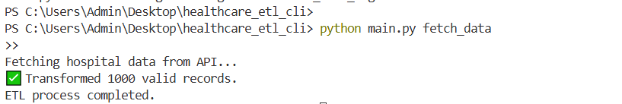
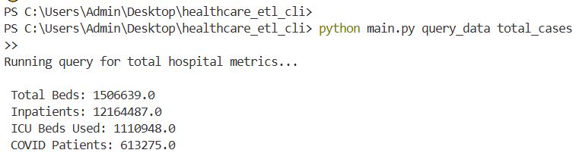
Sample Queries & Analysis
1 ) Python main.py list tables
2) Python main.py fetch data
3) python main.py query data total cases

Slide 12
Conclusion
This project delivers a robust and scalable ETL pipeline tailored for healthcare data needs.
Successfully integrates real-time data extraction from public APIs with efficient data transformation and secure MySQL storage.
The command-line interface simplifies data handling and allows users to run operations and analytics without complex tools.
Emphasizes real-world skills in modular Python development, database operations, and automated data pipelines.
Positions the system as a valuable tool for monitoring hospital capacity, analyzing COVID-19 impact, and making data-driven decisions

Slide 13
THANK YOU

